Slide 1
Ob La Di, Ob La Da

Slide 2
Quick Facts
It was the first commercially successful ska/raggae song.
Paul McCartney wrote it and got the idea from a Jamaican friend of his. Jamaica is where ska/raggae had originated.
All of the other Beatles hated the song, especially John Lennon.
It was originally intended to be played much slower until John Lennon angrily sat down at the piano and demanded it be played much faster. That is the version that was recorded.
It came from the White Album.
No Doubt and the Fray cover this song
Released in 1968

Slide 3
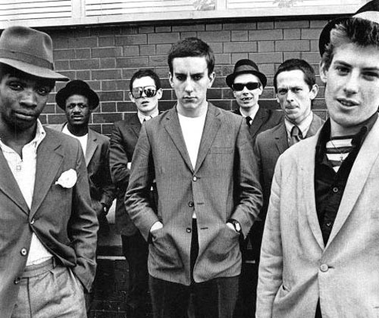
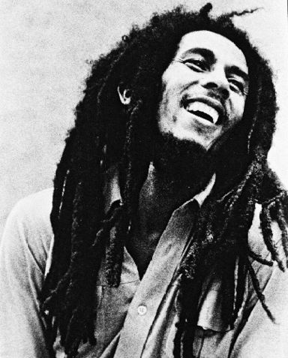
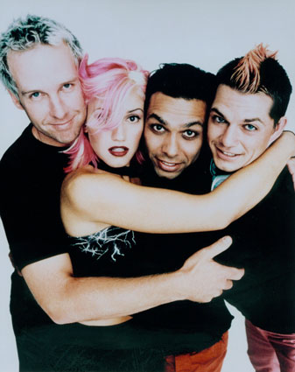
RAGGAE SKA
One Love – Bob Marley
No Woman No Cry – Bob Marley
Pressure Drop – The Specials
Total hate – No Doubt

Slide 4
And who was the first to do it successfully?

