Slide 1
Music of The World
Tuvan Throat Singing

Slide 2
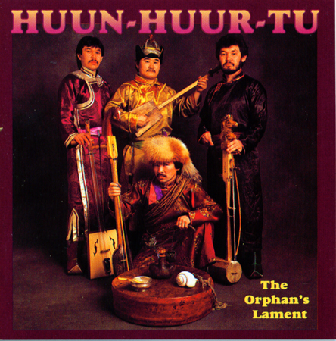
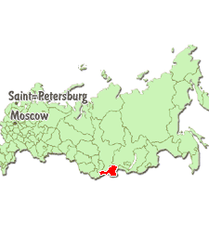
Tuvan Throat Singing
Tuva is a small republic inside of Russia
Own constitution and Language

Slide 3
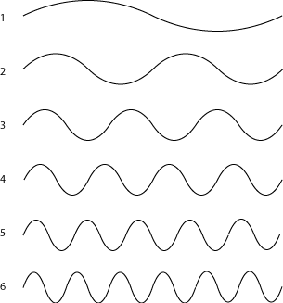
How Do They Do That?
Every sound has a series of overtones.
Overtone series
Different harmonics for different sounds.
Tuvan’s can isolate specific overtones from their voice and turn it into a melody

Slide 4
Where else can I find throat singing?
Canada
Nunavut
Inuit Throat Singing
Traditionally an art form
Today more of a game
Click here to watch clip

